Slide 1

Growth and development Overview
Third Stage
Dr. Moustafa Alshammari
Growth and Developments

Slide 2
Learning Objectives:
Mastery of content in this chapter will enable the student to:
Identify the importance of growth and development.
Describe and differentiate between growth and development.
Recognize and discuss the factors that influencing growth and development.
Describe the stages of development.

Slide 3
Growth and Development
Definitions:
Growth:
It is the increase in physical size of the
whole body or any of the parts of the body.
Because of cell division and synthesis of
proteins. It causes a quantitative change in
the child's body.
Growth can be measured accurately in
inches, centimeters, pounds or kilograms.

Slide 4
Development:
It refers to progressive increase in skills and capacity of functions.
It causes a qualitative change in the child’ functioning.
Development can be measured but its measurements are not so accurate as growth as it is measured through observation.

Slide 5
Maturation:
Literally, it means ripen.
It is described as ageing or an increase in child's competence and adaptability.
It is usually used to describe qualitative changes in a structure, i.e., the structure begins to function or to function at a higher level depending on the child's heredity.
Notes:
Let's consider a 2-year-old child named Emily. Emily's parents have noticed that she has started to speak in more complex sentences and is pronouncing words more accurately than she did a few months ago.
Emily's improved language skills are a result of maturation, particularly the maturation of her brain's language centers. While external factors such as exposure to language and interactions with caregivers also play a role, her ability to produce more accurate and complex speech is a qualitative change influenced by her biological development.

Slide 6
Principles of growth and development:
Growth and development are continuous processes.
Each child has his own rate of growth and development.
Both growth and development are synchronous. Different body parts and developmental areas develop at different rates. Each body part has its own time to grow.
All areas of growth and development are interrelated (physical, psychosocial, cognitive and motor) to meet the child’s basic physiological needs.

Slide 7
Children’s behavior is directed towards competency.
Growth and development progress from midline towards periphery.
Growth and development occur in an orderly sequence.
The direction of development is Cephalocaudal, i.e. the infant controls his head before he can sit, and crawls before he can walk.
General to specific: at the beginning all faces and sounds appear same to him/her, then stars to distinguish mother’s face and sound.
Development is relative

Slide 8
Factors affecting growth and development:
Hereditary factors: These are responsible for the characteristics of :
      certain anomalies,
      individual pattern of growth,
      some diseases
      certain types of short stature.
Congenital defects: These may be due to heredity or abnormal environment during embryonic life.
Endocrine factors: These can produce normal variations and cause growth variation.

Slide 9
*Environmental factors: Environmental factors such as
    the mother's nutritional status,
    exposure to infectious diseases and pathological conditions
    the socioeconomic conditions of the family affect the health of the embryo, infant and child.
*Nutritional factors: Growth of the baby depends on adequate consumption and proper utilization of suitable types of food. Specific deficiencies cause alterations in growth and development.
Notes:
Environmental Factors:
Mother's Nutritional Status:
Example: Maria, a pregnant woman, has a diet that lacks essential nutrients like folic acid. As a result, her developing fetus is at a higher risk of neural tube defects, such as spina bifida, due to insufficient folic acid intake during pregnancy.
Exposure to Infectious Diseases:
Example: Sarah, a toddler, is exposed to measles in her daycare center. If she contracts the disease during her early years, it can lead to complications such as hearing loss or developmental delays.
Socioeconomic Conditions:
Example: A family with limited financial resources struggles to provide nutritious food and a safe living environment for their child. This socioeconomic disadvantage can lead to malnutrition and developmental disparities in the child compared to peers from more affluent families.
Nutritional Factors:
Adequate Nutrition:
Example: A child who regularly consumes a balanced diet rich in fruits, vegetables, and protein sources is more likely to have healthy growth and development compared to a child with a diet primarily consisting of processed foods and sugary snacks.
Specific Nutritional Deficiencies:
Example: A deficiency in iron can result in anemia in a child, leading to symptoms like fatigue and impaired cognitive development due to insufficient oxygen delivery to the brain.
Breastfeeding:
Example: Emily's mother exclusively breastfeeds her during the first six months of life, providing her with essential nutrients and antibodies. As a result, Emily experiences healthy growth and a reduced risk of infections.
Malnutrition:
Example: In a region affected by food scarcity, children may experience malnutrition due to inadequate access to nutritious food. This can lead to stunted growth and developmental delays in the affected children.
These examples illustrate how environmental factors, such as a mother's nutrition and exposure to diseases, as well as nutritional factors, like diet quality and breastfeeding practices, can have a profound impact on a child's growth and development. Addressing these factors through proper nutrition and supportive environments is essential for promoting healthy child development.

Slide 10
*Activities: Normal growth and development depend on normal activities. A bedridden child would not grow as much as an active one.
*Illness and injuries: During birth, may cause a permanent damage to vital organs.
Notes:
1. Activities:
Physical Activity: Engaging in physical activities and exercise is crucial for a child's healthy growth and development. It promotes muscle and bone development, cardiovascular health, and overall physical fitness.
Example: Tim, a 10-year-old boy, participates in regular physical activities like swimming, biking, and playing sports. His active lifestyle contributes to his physical growth, strength, and cardiovascular health.
Cognitive Stimulation: Mental activities, such as reading, problem-solving, and educational games, are essential for cognitive development. These activities help build neural connections and enhance intellectual skills.
Example: Emily's parents read to her regularly and provide educational toys. This cognitive stimulation supports her language development, problem-solving abilities, and overall cognitive growth.
Social Interaction: Social activities and interactions with peers, family members, and caregivers play a significant role in a child's psychosocial development. They help children learn communication skills, empathy, and social norms.
Example: Sarah attends a preschool where she interacts with other children. These social interactions contribute to her emotional and social growth, helping her develop friendships and social skills.
2. Illness and Injuries:
Birth-Related Injuries: Injuries during birth, such as oxygen deprivation (birth asphyxia), can lead to permanent damage to vital organs, including the brain. This can result in developmental delays, cognitive impairment, or physical disabilities.
Example: A newborn experiences birth asphyxia during delivery due to complications. This lack of oxygen can cause brain damage and lead to cerebral palsy, affecting the child's motor skills and overall development.
Chronic Illness: Children with chronic illnesses, such as diabetes, cystic fibrosis, or cancer, may face challenges in growth and development. Managing these conditions and their treatment can impact a child's overall well-being.
Example: Lily, a 6-year-old, has been diagnosed with type 1 diabetes. Her daily insulin management and dietary restrictions are essential for controlling her condition and preventing complications that could affect her growth and development.

Slide 11
Types of Growth:
    Physical growth such as, weight, height, head and chest circumferences.
    Physiological growth such as, vital signs, and senses; (touch, hearing, smell, vision, and taste).

Slide 12
Types of Development:
Cognitive development (intellectual development e.g. reasoning, mental thinking…etc)
Emotional development e.g. loves, fear …etc.
Social development e.g. self concept, friendship, and development of senses such as sense of trust…etc.

Slide 13
Stages of Growth and Development
Prenatal period : From conception to birth:
Germinal period:1st two weeks of gestation (Zygote)
Embryonic period: 2 – 8 weeks (Embryo)
Fetal period: 8weeks – birth (Fetus)

Slide 14
Infancy: Birth to 12 months
  Neonate : Birth to 1 month
  Infancy: 1 month to 12 months
Early Childhood: 1to 6 years
  Toddler: 1-3 years
  Preschool: 3-6 years

Slide 15
4. Middle Childhood: 6 to 11 0r 12 years
  School age:
  6 to 12 years
5. Later Childhood: 11 to 19
  Prepubertal: 10 -13 years
  Adolescence: 13 years to approximately 18 or 19 years

Slide 16
Adulthood
Young adulthood: from 19- 25 years
Adult: from 26 – 40 years
Maturity: from 41 years - and above
7. Old age

Slide 17
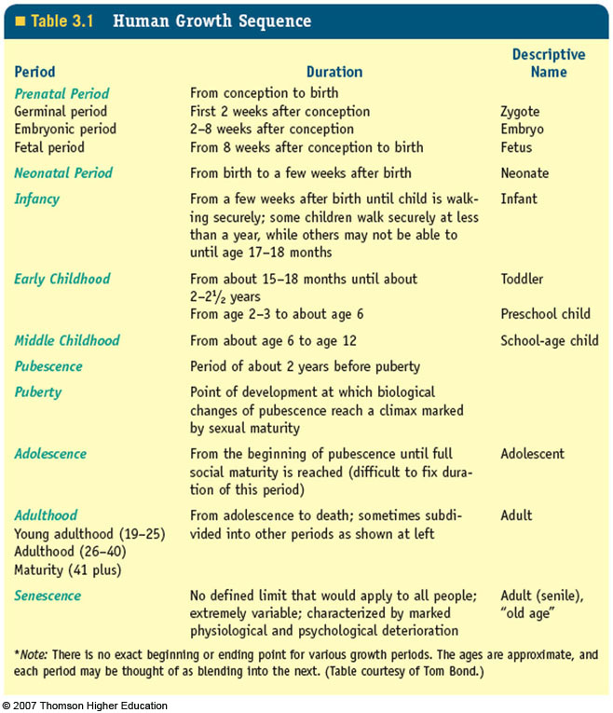

Slide 18
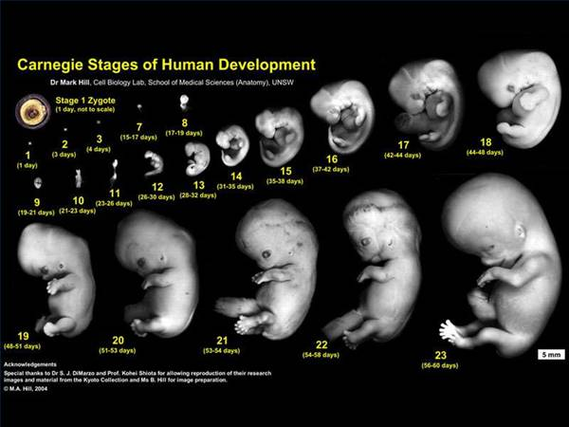
Embryo

Slide 19
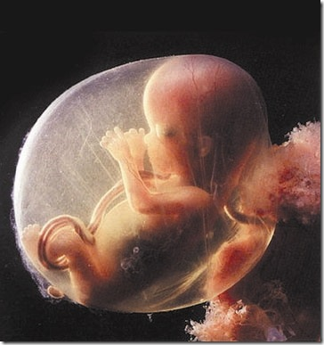
Fetus (12 weeks)

Slide 20
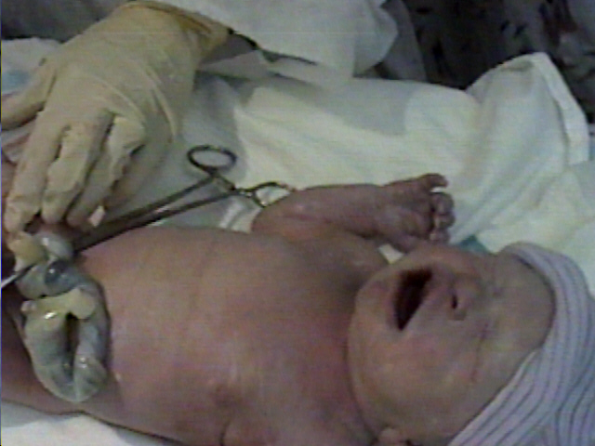
Newborn infant

Slide 21

Infant

Slide 22

Toddler

Slide 23

Preschool

Slide 24

School child

Slide 25

Preadolescent (Prepubertal)

Slide 26

Adolescent

Slide 27

Young adult

Slide 28

Mature (Older adult)

Slide 29
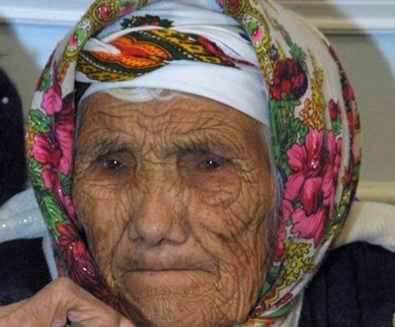
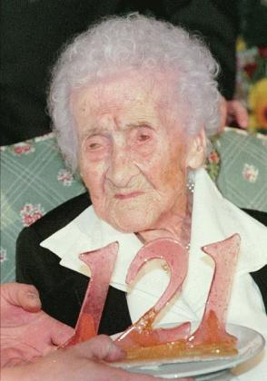
Old aged

Slide 30
Thank you
رمز الصف
lanuvlc

